Slide 1

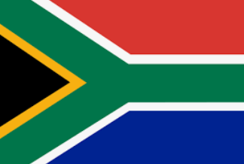
Giving London a more South African Flavour

Slide 2
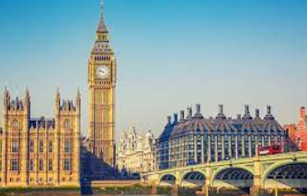

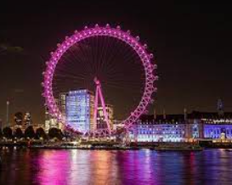
London, United Kingdom
Home to almost 9 million residents
Capital city of England (and the United Kingdom)
Cosmopolitan, multicultural mix of people
Big tourist attraction due to landmarks, rich history

Slide 3
What about the Cuisine?
The British are traditionally known for the following in terms of food/drink:
Fish & Chips
Full Breakfast (incl. eggs, bacon, toast, beans, mushrooms, bangers and tomatoes)
Roast dinner (meat and veggies)
Cornish Pasty
Tea
Shepherd’s Pie
Steak & Kidney Pie
Eton Mess
But what about introducing them to something with a more South African flavour?

Slide 4
Who would be interested?
According to businesstech.co.za, there were approximately 255,000 South African expatriates living in London by the end of 2019.
We know how homesick people can get when they miss the comforts and familiarity of home, these expats (and locals) will be curious to try out the South African food and drinks.
This gap in the market will be appreciated by these people.
They can indulge in South African favourites such as:
Boerewors, gatsbies, rooibos tea, bunny chow, potjiekos, biltong, droe wors, Devil’s Peak craft beer or KWV Brandy, to name a few
Info sourced from www.nichemarket.co.za

Slide 5
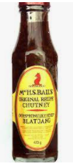
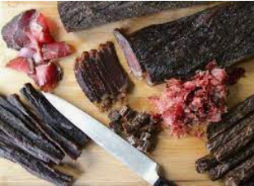
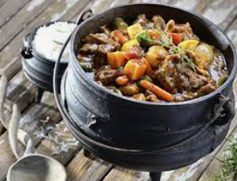
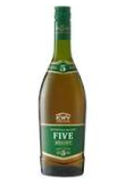
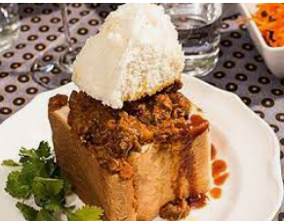
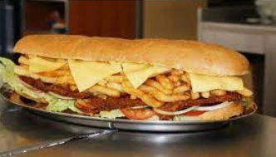
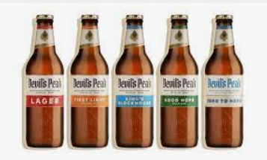
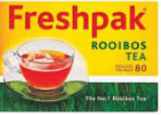


Slide 6
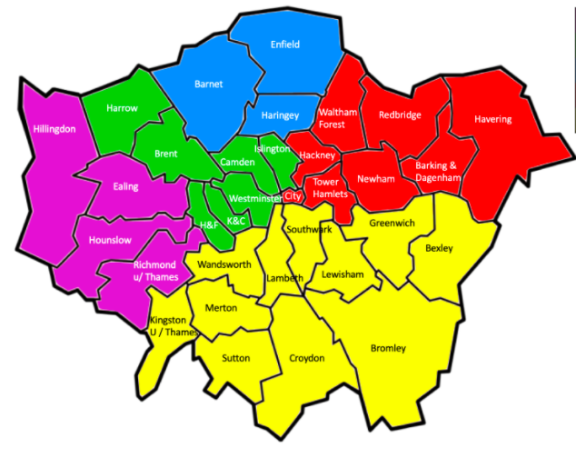
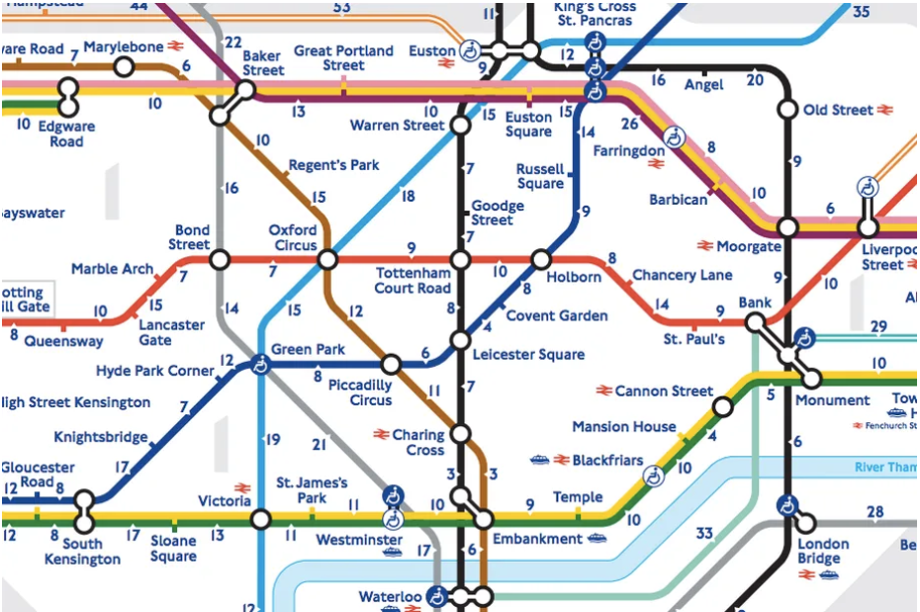
Commuting around London is relatively easy
But I would like this restaurant to be central – in the Camden Area

Slide 7
Conclusion
This will lead to many satisfied South African expatriates frequenting this restaurant.
They will likely tell their friends, leading to more sales and interest.
Creating the possibility for more of these types of restaurants to open.
Giving South African restaurants an even better chance to develop in other foreign countries and cities (not only the capital cities either.

